Slide 1


Green Pace
Security Policy Presentation
Developer: James Nikolaou
Notes:
Hello everyone, my name is James Nikolaou in CS405 2024 and I am presenting the security policy for Green Pace.

Slide 2

OVERVIEW: DEFENSE IN DEPTH
This security policy is intended to provide a secure and robust protection policy within the realm of defense in depth. It utilizes core security principles, C and C++ coding standards, encryption policies, Triple-A policies, and appropriate Unit testing to provide a multi-layered defense against any and all threats.
Notes:
In an overview, defense in depth is the idea of providing multiple layers of defense methods to create an all catching “web” like a multi-layered spider web to trap all its prey, or in our case security risks.
This security policy is to implement this concept via security principles, C/C++ standards, encryption and triple-a policies, and unit testing examples of these standards and policies in effect.
This presentation will also cover some pitfalls in the security policy and recommendations on how to remedy them.

Slide 3
THREATS MATRIX
The threats are arranged in order of likeness and priority. How likely a threat is should determine how often it should be looked for and automated out if possible.
The priority threats need to be addressed as soon as possible as they may cause the most disruption within the product and security risks.
Likely STD-001-CPP STD-002-CPP | Priority STD-003-CPP STD-004-CPP STD-005-CPP
Low priority STD-008-CPP STD-009-CPP STD-010-CPP | Unlikely STD-006-CPP STD-007-CPP
Notes:
Our graphic on this slide covers a threats matrix, organizing the standards should they be ignored into the level of likeliness and priority of these errors.
We want to focus on the likeliness of threats first as if there is a common threat to automate or implement a specific policy to mitigate it.
Next, we want to focus on the priority level. If it is a greater threat, then we need to focus on that before a more minor threat.

Slide 4
10 PRINCIPLES
Validate Input Data
Data Type
Data Value
Heed Compiler warnings
Data Type
String Correctness
Memory Protection
Architect and Design for Security Policies
SQL Injection
Exceptions
Expressions
Containers
Object Orientated Programming
Keep It Simple
Containers
Object Orientated Programming
Default Deny
Exceptions
Expressions
Object Orientated Programming
6. Adhere to the Principle of Least Privilege
Exceptions
Expressions
Containers
7. Sanitize Data Sent to Other Systems
Memory Protection
8. Practice Defense in Depth
Object Orientated Programming
Memory Protection
Data Type
Data Value
SQL injection
Use Effective Quality Assurance Techniques
Assertions
Expressions
Exceptions
10. Adopt a Secure Coding Standard
Containers
Object Orientated Programming
Notes:
Here are the ten principles of the security policy and the standards that relate to each one.
Validating input types is as it sounds, ensuring the right kind of data and the value of the data is appropriate.
Compiler warnings are there to help the developer, so it’s best to at least refer to them if they arise. Generally, they cover data management, data types, and string correctness, as well as overall proper implementation of the code itself.
Architecting and designing for security policies is the idea of creating code that is security focused to help mitigate security risks in development and further on like SQL injections. These are standards that promote the security first concept.
Keep it simple. Sounds silly maybe but the simpler something is (as long as it meets all the criteria of the product) the easier and more efficient it is to manage and develop. Below are standards to help enforce this principle.
Utilizing a default deny concept helps prevent security risks by assuming EVERYTHING is a security risk unless proven otherwise. It keeps everything on lockdown until the proper authorization is received. The standards below are tools to help promote this principle.
Adhering to the principle of least privilege is along the same through process as ‘Default Deny’. Only providing the minimum level of privilege needed to accomplish a task helps keep unauthorized users away from sensitive data. These standards help enforce this principle.
Sanitizing data sent from other systems helps keep things safe by removing potential threats tagging along seemingly safe data transmissions. Generally, they affect memory or data type vulnerabilities.
Practicing defense in depth. The example of the spider web I used earlier is put into application with these standards below.
The effective use of quality assurance techniques ensures that the product is up to standards via constant testing and review. These standards are examples of implementing this principle.
Adopting a secure coding standard is key to providing the same results with different products. The more the same things are, the easier they are to develop, test, and fix. These standards support this ideology.

Slide 5
CODING STANDARDS
When ranking vulnerabilities, it is important to identify what would cause the most damage to the product to the least damage to the product. Referring to the coding standards outlined, Data type, SQL injection, and Memory protection will most likely cause the highest level of damage, thus they need to be mitigated first.
Once the level of damage is identified, it is important to identify the likelihood of the problem occurring. Data type/value and string correctness are probably the most common errors in C/C++ coding, so these should be identified next.
Finally creating proper testing and orientation of the code will help prevent future errors and help find current errors as well. Assertions, exceptions, expressions, containers, and OOP are all standards that promote efficient coding and testing.
Data Type
Data Value
String Correctness
SQL Injection
Memory Protection
Assertions
Exceptions
Expressions
Containers
Object Orientated Programming
Notes:
On the right we have our 10 coding standards listed. These standards help us mitigate vulnerabilities, but in the event one happens what do we do? It’s best to rank them based on what will do the most to the least amount of damage to the product or service.
Once the level of damage is identified, what is the actual likelihood something will happen? Not saying to ignore things that may not happen, but they can be focused on later if there’s a good chance it may not occur at all.
The use of proper testing and development of the code within the product will protect the product from everything on the development side of things, and help prevent attacks when the product is released.

Slide 6
ENCRYPTION POLICIES
Encryption at rest:
Data at rest will be encrypted utilizing full-disk encryption at the server level and at the database level will utilize server-wide encryption policies. Both will utilize further backup strategies for case of major failure and recovery.
Encryption in flight:
Data in flight will be encrypted utilizing public key infrastructure for incoming/outgoing data exchanges including but limited to messages, attachments, file transfers, web traffic, and all forms of communication. SSH, password access, and restrictive communication channels will be in use to prevent malicious activity.
Encryption in use:
Data in use will utilize identity security protocol to ensure the correct person/body is allowed access only when all fields of identification are satisfied, and least privileged role authority to only allow access for only necessary actions and functions. Utilizing a system with multi-tiered approval for access change requests will help ensure levels of access are cross-examined to keep sensitive data secure.
Notes:
We have three main encryption policies.
First is encryption at rest, or at the hardware level and code level on our end. Full disk encryption for sever and databases help provide security at the development level.
Encryption in flight is during the transmission of data, how do we keep it safe. Encryption of incoming/outgoing data of all types via SSH, password access, and other safety methods help prevent malicious intent.
Finally encryption in use. Proper identification to ensure that only authorized users are utilizing the product help keep things safe. A least privileged approach keeps people away from sensitive data above their clearance and change request approval systems allow for tracking of changes.

Slide 7
TRIPLE-A POLICIES
Authentication
The process of identifying a user, usually done via username/password. This controls whether the user has access to the system or not to ensure only authorized personnel are given access to the system.
Authorization
Authorization provides access on a least-privilege system to authenticated users to control the level of mobility and authority they have over the system. This also allows for the addition of new users, modification of access, or full removal of access.
Accounting
Accounting is the tracking of user interactions with the system. It monitors the files accessed by users as well as any changes to the database via user interaction.
Notes:
Triple-A, or the policies outlined below, are concepts to promote security at a personnel level.
Authentication is identifying a user via usually a login or security key and identifies their access level.
Authorization is the concept of authenticated users to be given access to whatever level of privilege they require on a least-privilege system. Here we can change the level of access as well, from new users, to existing levels, to removing users.
Accounting is basically keeping tabs on everything. Like the idea that everything needs to be accounted for, all actions are monitored to identify potential hazards.

Slide 8
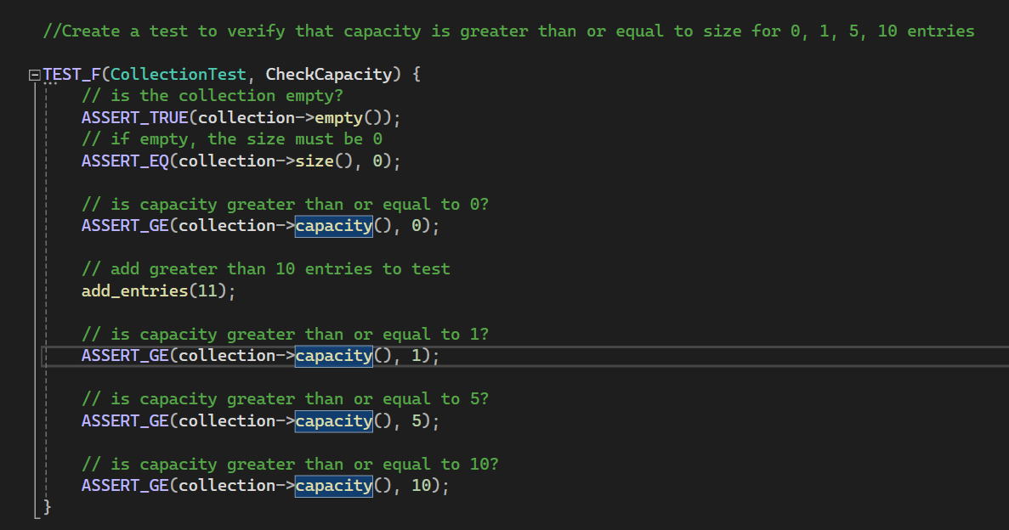
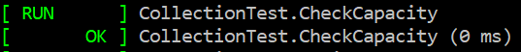
Unit Testing Check Capacity
Notes:
To begin our examples of unit testing, we have a test to check the capacity of a collection. We test for at empty is a collection empty, and if we add items does the collection pass checks of greater than standard amounts? In this test it does indeed pass as a true test.

Slide 9
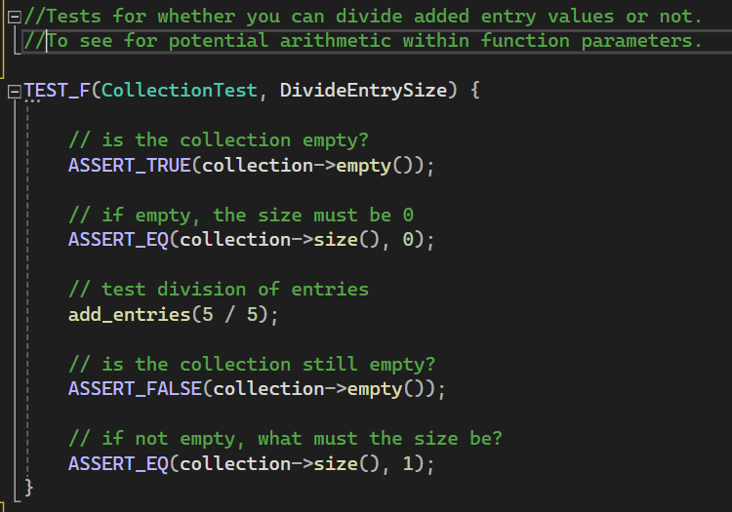
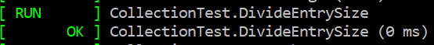
Unit Testing Divide Entry Size
Notes:
This test checks if arithmetic can be done within the parameters of a function for more indepth level coding later down the road. We check that the container is empty, and then divide 5 by 5 to get 1 added entry, and ensure that only one entry is added.

Slide 10
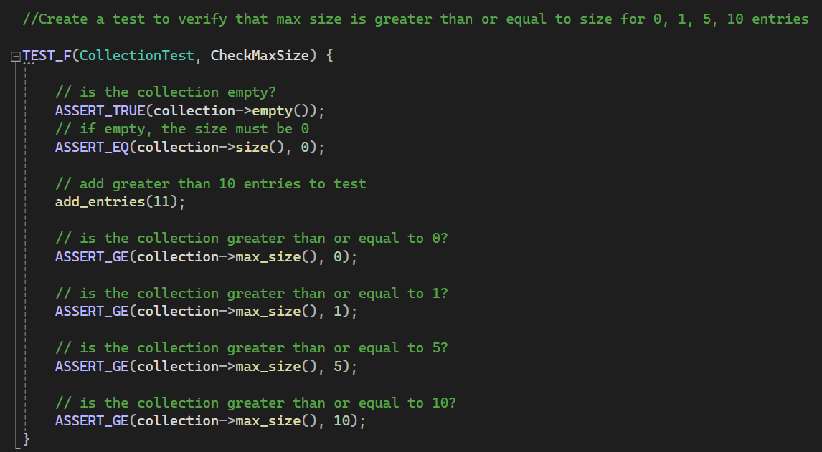
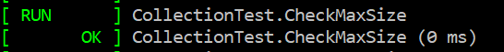
Unit Testing Max Size
Notes:
As the name states, we are checking the max size of a collection. We ensure its empty first, add 11 values, and check that we indeed have more or equal to the standard testing values.

Slide 11
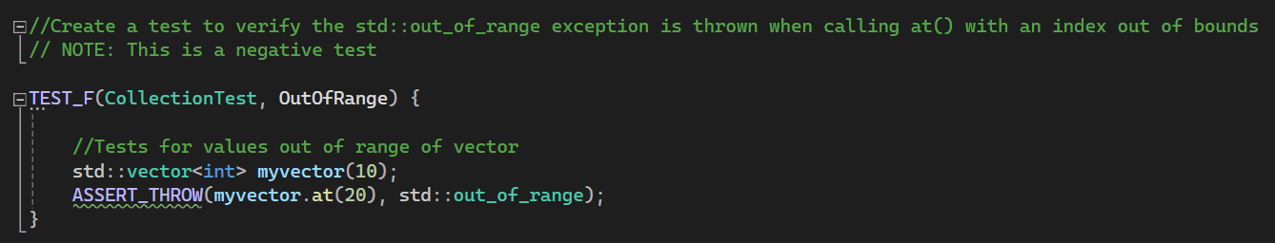
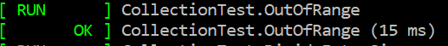
Unit Testing Out of Range
Notes:
Here is our first negative test. We are checking for values within a vector ‘myVector’ and adding 10 values, then trying to see what happens if we access outside of the 10 values. We are looking for the 20th value, which of course doesn’t exit. Should our test work, it should throw an error (or with the assert_throw statement) pass the test.

Slide 12
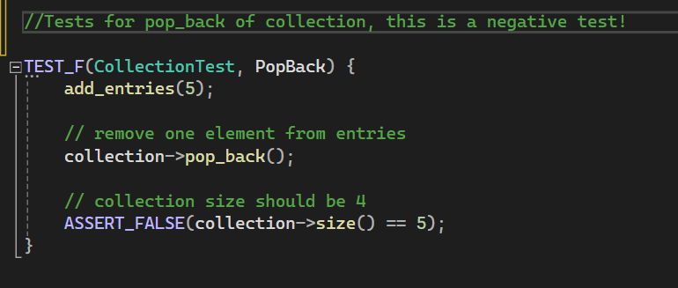
Unit Testing Pop Back
Notes:
Our second negative test, again testing to ensure something fails when it should fail. We want to check if using the pop_back removes the value at the end of a collection. We add 5 for testing, try to remove one, and then check that the collection size should not be the same size as before.

Slide 13
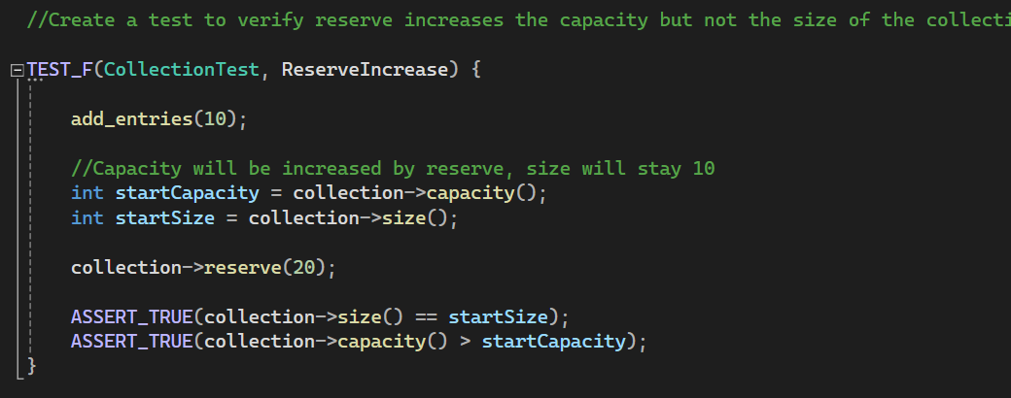
Unit Testing Reserve Increase
Notes:
Our last test is checking to see if when increasing the reserve of the collection (or the capacity) increases but the overall size stays the same.

Slide 14

AUTOMATION SUMMARY
Notes:
Here is our automation summary. The devSecOps system navigates through the pre-production and production cycles back and forth as needed from monitoring the progress at each phase. This diagram covers all the various phases and what occurs in them.

Slide 15
TOOLS
The DevSecOps pipeline is a constantly evolving and developing system that integrates security through out the entirety of the development and live portions of the product.
Security tools are layered through out the automation process. Within the design area, test design is created. In the build area, building the code securely is implemented. Within the verify and test area tools like unit testing are used. Transition and health check is where security measures may be adjusted, and Monitor and detect is the use of security tools in live environments. Maintain and stabilize identifies the level of effectiveness of the security and returns status to normal.
Examples of tools include:
Parasoft C/C++ test - Used in the testing portion of the design.
Load Ninja – Used in the verify and pre-production section.
Intruder – Postproduction tool that monitors the health of the system and performs penetration testing.
Notes:
DevSecOps utilize security tools through out the automation process to ensure testing is done all along the development cycle to monitor the health of the product. Parasoft and load ninja focus on the development side where intruder focues on post production and performs penetration testing like malicious attacks.

Slide 16
RISKS AND BENEFITS
Pros:
Provides security focus throughout entire development and post development cycle.
Early and continuous implementation allows for easier and more effective approach
Provides greater defense against attacks and poor code quality
Allows for less damage if an attack were to occur as each section can be a reference point in security development
Cons:
Upfront cost
Time commitment
Higher level of development required
Increases complexity and size of product and scheduling
Conclusion:
Overall, the pros heavily outweigh the cons utilizing early security development and automation. The initial cost of time and money are a small investment to be made when considering a potential security breach could cost tenfold the initial investment. Implementing security in all portions of development of the product ensure that the defense is well diversified and able to protect against many forms of potential threats.
Notes:
For our security policy, there are pros and cons. The pros are providing constant security through out the entire development and post development cycle, allowing us to implement earlier and constant testing for continual review of the product meeting standards. This will allow the product to be more secure before production and release instead of testing for all possible errors after. Of course the cons would include the time and money commitment, and it does take quite a bit of work to schedule and build this system. But overall the small cost of investment is far cheaper than paying out for damages should a security breach happen.

Slide 17
RECOMMENDATIONS
Build Pre-Production: No repositories are defined. Will need to identify trusted repositories and implement.
No form of enforcement for each stage is defined. Will need to identify and implement a proper enforcement technique to ensure all defined criteria are met.
Encryption theory is reviewed but no level of encryption is enforced. Will need to implement standard encryption methods with the option to modify as needed due to product/customer requirements.
Notes:
This policy does have a few flaws. Pre production has no depositories refined, no enforcement for each stage, and encryption ideology is discussed but never enforced or examples provided.

Slide 18
CONCLUSIONS
The use of a well-defined repository provides: “version control capabilities … track changes made … enhance collaboration … built-in tools for code review … “(Bluestein, 2024). This will help maintain uniform production, view changes made, and help with designing future development processes.
With no form of enforcement provided for each stage, it may lead to redundancies and stagnant code. Some examples of enforcements include: “… Automatically delete data that has exceeded its retention period” or to block users who attempt to access unauthorized data (Medium, 2023).
Encryption is the idea to modify the visibility of data via an algorithm or method that obscures the data to keep it safe and secure unless provided the appropriate key/password to view the data. Examples of encryptions include: Triple DES, AES, RSA, Blowfish, and Twofish (Arcserve, 2023).
Notes:
Referring to the recommendations from the last slide, we see that a well defined repository provides multiple benefits including version control capabilities, changes tracker, improve collaboration, and provide built in review tools.
A lack of enforcement for each stage may produce confusion, stagnant code, and redundancies. Examples to improve this include automatically deleting data when it exceeds its retention period and blocking users who attempt to access unauthorized data.
Encryption is critical to keeping data safe. Some methods we could use are Triple DES, AES, RSA, Blowfish, and Twofish.
This concludes my presentation, thank you for watching!

Slide 19
REFERENCES
&#9854;&#65039;&#9729;&#65039;, L. (2023, February 20). Security policy enforcement script coding. Medium. https://softwaresennin.medium.com/security-policy-enforcement-script-coding-c355a5c94771#:~:text=For%20example%2C%20a%20script%20designed,are%20not%20authorized%20to%20access.
Arcserve. (2023, September 19). 5 common encryption algorithms and the unbreakables of the future. https://www.arcserve.com/blog/5-common-encryption-algorithms-and-unbreakables-future
Bluestein, N. (2024, May 24). What is a code repository?: Harness. Harness.io. https://www.harness.io/harness-devops-academy/what-is-a-code-repository#:~:text=Code%20repositories%20provide%20a%20structured,to%20previous%20versions%20if%20needed.
Foster, S. (n.d.). DevSecOps Pipeline Overview: DevSecOps Simplified. Perforce Software. https://www.perforce.com/blog/kw/devsecops-pipeline-overview#:~:text=Free%20Klocwork%20Trial-,What%20Is%20a%20DevSecOps%20Pipeline%3F,secure%20software%20faster%20and%20easier.
C++test - Check C++ and C Code for Compliance. Parasoft. (2021, June 7). https://www.parasoft.com/products/parasoft-c-ctest/.
Create and Run Load Tests in Half the Time. LoadNinja. (n.d.). https://loadninja.com/.
Log Management & Analysis Software Made Easy. Logentries. (n.d.). https://logentries.com/.
An Effortless Vulnerability Scanner. Intruder. (n.d.). https://www.intruder.io/.

